Slide 1
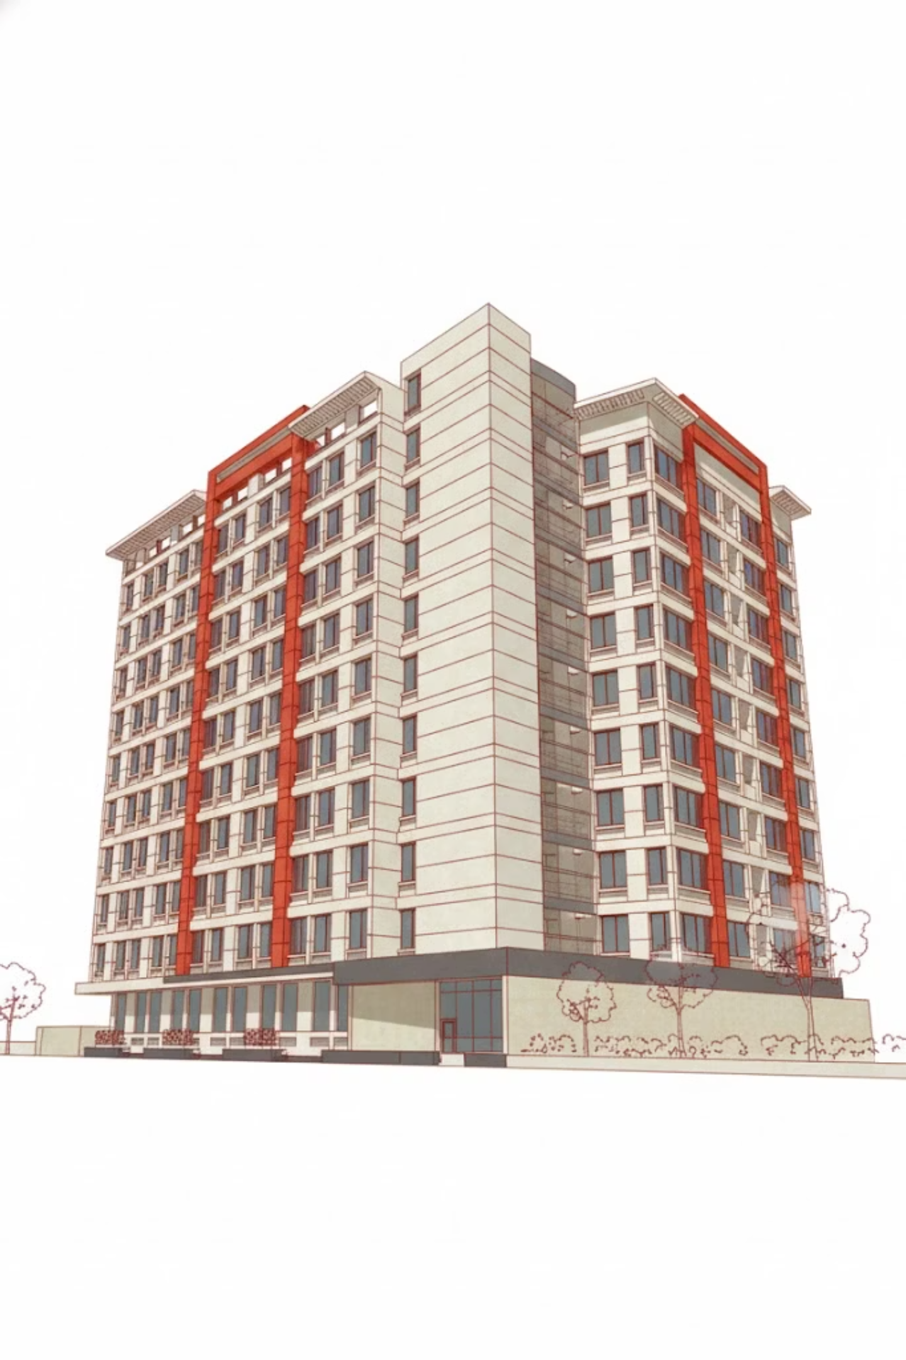
KCMSC Campus Navigator
Project Presentation by Khan Jariff Al Naseeb and his team

Slide 2
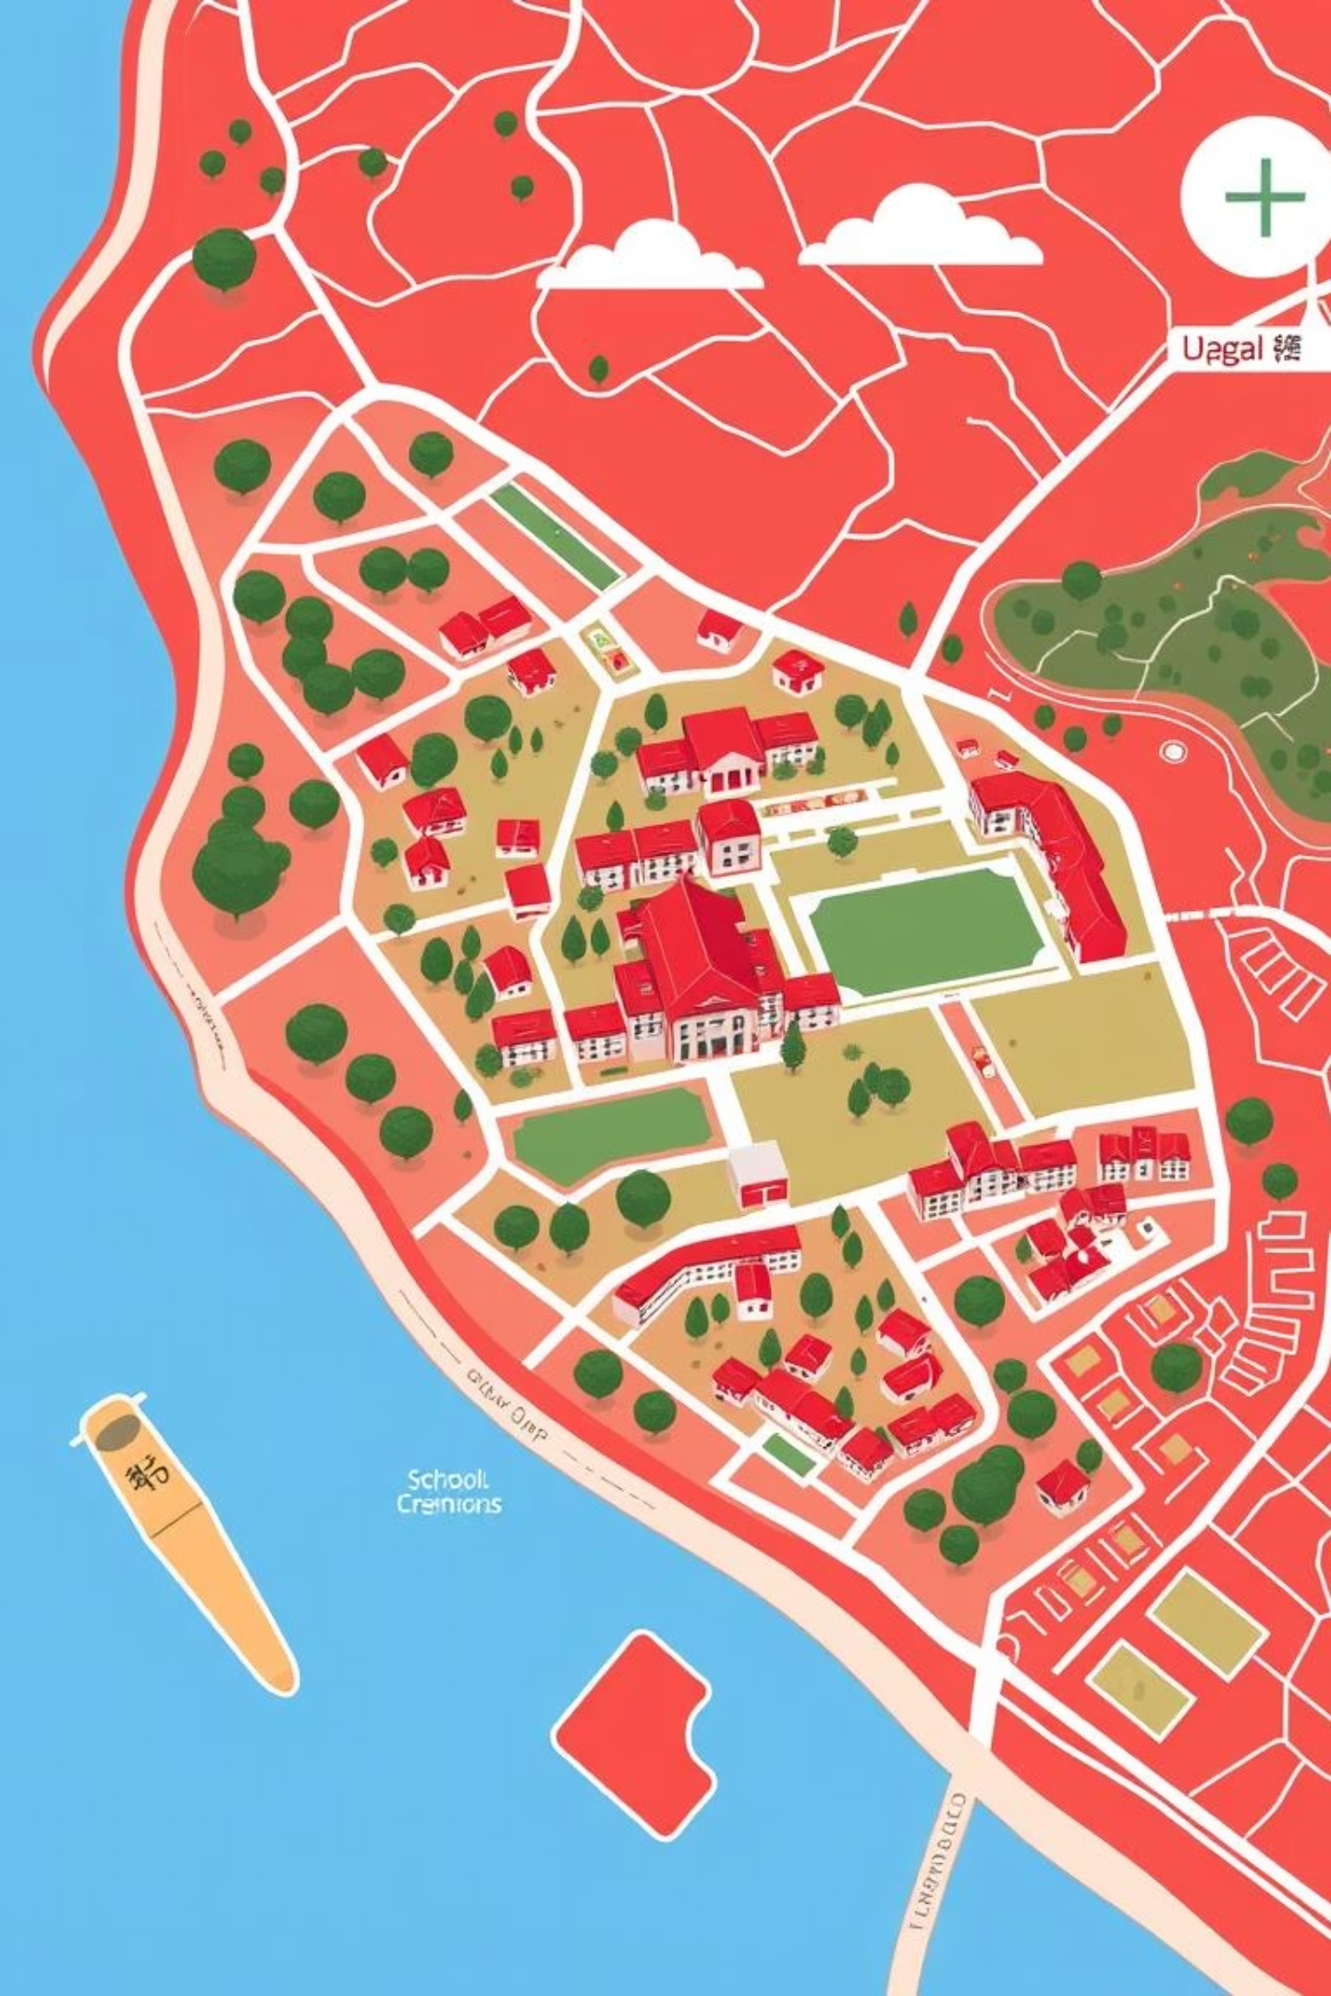

Introduction: Navigating Modern Campuses
This system provides a dynamic, digital representation of school layouts, designed to enhance navigation and facility management.
Simplifying complex spaces for a smarter campus.

Slide 3

The Problem: Outdated Floor Information
Inefficient Traditional Maps
Paper-based or static digital maps are often outdated and difficult to maintain, leading to confusion and wasted time.
Lack of Digital Structure
Without a structured digital system, vital floor information is disjointed, making it hard for staff and students to find their way.

Slide 4

Our Purpose: Precision and Clarity
Solving Navigation Challenges
Why Accuracy Matters
Enhanced Organization
We aim to eliminate navigation guesswork, providing immediate access to accurate floor plans and room locations.
Precise data ensures efficient operations, improves emergency response, and enhances daily campus life.
A well-organized digital system streamlines facility management and information access for all users.

Slide 5






Core Features of Our System
Digital Structured Data
Room Search
ASCII Maps
Organized, accessible floor data.
Instantly locate any room.
Clear, text-based visual layouts.
Clean Formatting
Easy Updates
Floor Viewing
Consistent, readable presentation.
Seamless maintenance of floor plans.
Explore the whole campus floor by floor

Slide 6
Our Dedicated Team Workflow
Our collaborative approach ensures seamless development and precise data management.
Khan Jariff Al Naseeb
1
Chief Architect & Project Lead
Oversees design, core coding, workflow, and ensures project quality.
Nazim Uddin Sayem
2
Lead Data Engineer
Collects, processes, and analyzes floor data, ensuring accuracy.
Tahmid Hossain Zarif
3
Data Analyst & QA Engineer
Assists with data updates, tests workflows, and ensures correct entries.
Farhan
4
ASCII & Formatting Lead
Generates ASCII maps, oversees code formatting, and aesthetics.
Ishtiaq Ahmed
5
Technical Writer & Curator
Manages documentation, README, Wiki, and user resources.

Slide 7



Progress & Upcoming Development
Completed Floors
1
Floors 1-5 have been successfully mapped and integrated.
2
Current Focus: Floors 6, 7, 8
Our team is actively working on updating data for these critical floors this week.
Challenges & Future Improvements
Challenges: Data Accuracy, Branch Management, Formatting Consistency
Improvements: Better ASCII Renderer, Potential UI, Faster Pipeline, Multi-Building Support

Slide 8



Conclusion: Enhancing the Campus Experience
Positive Impact
This system fundamentally improves campus navigation and facility management.
Benefit for All
Students and staff gain easy, reliable access to essential floor information.
A clearer path to a more efficient and connected school.

